Slide 1
Chapter 3 Requirements Analysis
Source of PP slides :
- Sommerville, I. 2011. Software Engineering. 9th edn. Addison-Wesley.
- Lamsweerde, A. V. 2011. Requirements Engineering: From System goals to UML Models to Software Specification. 2nd ed.Wiley.
- Weigers, K. And Beatty, J. 2013. Software Requirements. 3rd edn. Microsoft Press.
- Bennett, McRobb and Farmer: Object Oriented Systems Analysis and Design Using UML, (4th Edition), Chapter 8, McGraw Hill, 2010.

Slide 2
Lesson objectives:
Explain different classification of requirements
Understand conceptual modeling
Introduce some notations defined in the Unified Modeling Language(UML)
Understand architectural design and requirements allocation
Understand some commonly used requirements analysis approaches

Slide 3
Requirements Analysis: outline
Requirements Classification
Conceptual Modelling
Context Models
Interaction Models
Structural Models
Behavioral Models
Architectural Design and Requirements Allocation
Requirements Negotiation
Requirements Analysis Approaches

Slide 4

Requirements Classification (1)
Analyst must classify the requirements to various categories so that they can document and use it appropriately
Requirements can be classified on a number of dimensions (next slide…)

Slide 5
Requirements Classification (2)
Some common requirements classified dimensions:
Functional or Nonfunctional Requirements (as discussed in previous chapter – recall)
Product or Process Requirements (as discussed in previous chapter – recall)
Data Requirements – eg…
External Interface Requirements – interface requirements with hardwares, other softwares and users

Slide 6
Requirements Classification (3)
Some common requirements classified dimensions: (cont’)
The Requirement Priority – the higher the priority, the more essential the requirement is for meeting the overall goals of the software. Eg: mandatory, highly desirable, desirable or optional.
The Scope of the Requirements – refers to the extent to which a requirement affects the software and the software component. Requirements of global scope may strongly affect the s/w architecture and the design of many components, whereas requirements of narrow scope may have little impact on the satisfaction of other requirements

Slide 7
Requirements Classification (4)
Other classification may be appropriate depending upon the organization’s normal practice and the software application itself
Reading : Text books and research from internet on other classification of requirements …

Slide 8
Requirements Analysis: outline
Requirements Classification
Conceptual Modelling
Context Models
Interaction Models
Structural Models
Behavioral Models
Architectural Design and Requirements Allocation
Requirements Negotiation
Requirements Analysis Approaches

Slide 9
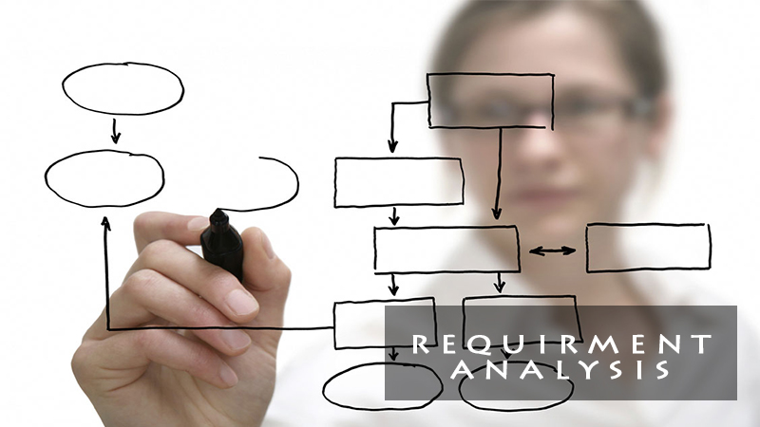
Conceptual Modeling
The development of models of a real-world problems is the key to software requirements analysis
Purposes of modeling:
Aid in understanding the current system strengths and weaknesses
Depicting the requirements/solution of new system
Aid in communicating with customers

Slide 10

Conceptual Modeling
Several kinds of models can be developed during requirements analysis
Represent using some kind of graphical notation, which is now almost always based on notations in the Unified Modeling Language(UML)
Some common diagrams generated during requirements analysis stage include:
Use case diagram
State diagram UML Notation
Class diagram
Sequence diagram
Data flow diagram
Data model
etc

Slide 11
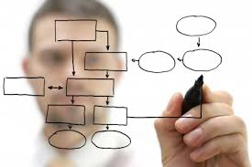
Conceptual Modeling
i) Context Models
ii) Interaction Models
iii) Structural Models
iv) Behavioral Models

Slide 12
Conceptual Modeling
i) Context Models
Used to illustrate the operational context of a system – they show what lies outside the system boundaries which may include external entities, hardware and other software
System boundaries are established to define what is inside and what is outside the system
Eg: Context Diagram of DFD (ie .Level 0 DFD)
{Refer to SAD course}

Slide 13
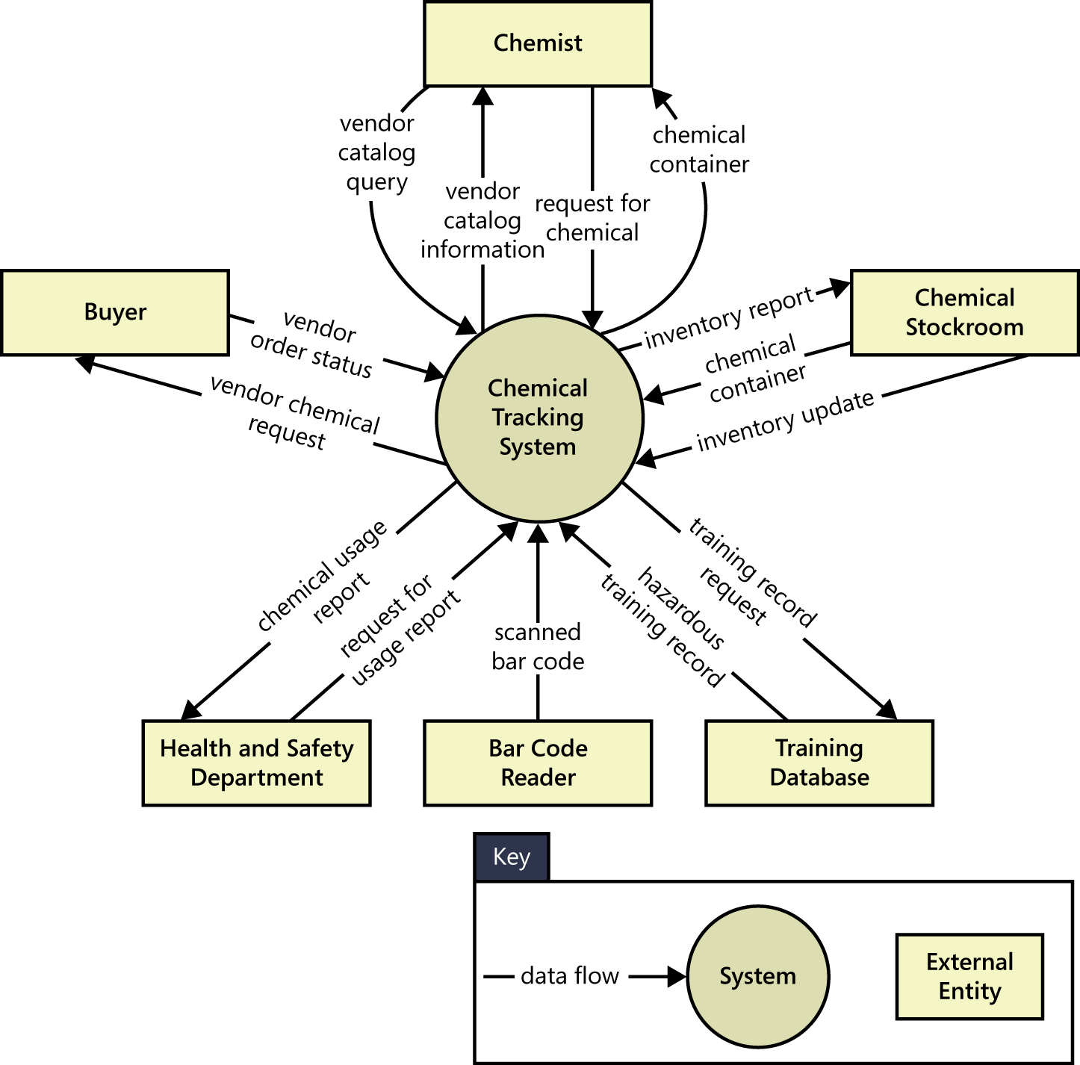
Example : Context diagram

Slide 14
Conceptual Modeling
i) Context Models
ii) Interaction Models
iii) Structural Models
iv) Behavioral Models

Slide 15
Conceptual Modeling
ii) Interaction Models
Modeling user interactions is important to identify user requirements
Modeling component interaction helps to understand proposed system structure
Eg: i) Use case diagram in UML {discuss in this chapter}
ii) Sequence diagram in UML {discuss in Chp 5}
iii) Data Flow Diagram (DFD) {Refer SAD course}

Slide 16
Conceptual Modeling
Generally,
Data flow diagram (DFD) is a graphical representation of the "flow" of data through an information system, modelling its process aspects. A DFD shows what kind of information will be input to and output from the system, where the data will come from and go to, and where the data will be stored. It does not show information about the timing of process or information about whether processes will operate in sequence or in parallel. {refer to SAD course for details}
Use case diagram at its simplest is a representation of a user's interaction with the system that shows the relationship between the user and the different use cases in which the user is involved.

Slide 17
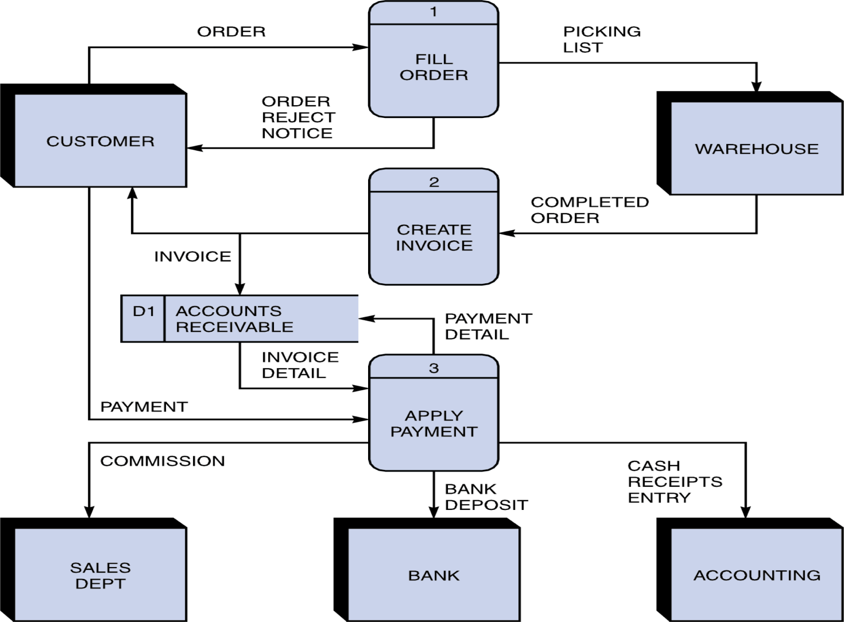
Example : Data Flow diagram

Slide 18
Use Case Diagram
Purpose:
Document the functionality of the system from the users’ perspective.
Document the scope of the system
Are supported by use case descriptions (behaviour specifications) that document the interaction between the users and the system.
Types:
Overview use case used to agreed a high level overview requirements
Detail use cases used to document all detail information needed for the use case

Slide 19
Use Case Diagram
Clinic System
Clinic System
Add Appointment
Maintain Appointment
Delete Appointment
Nurse
Nurse
Dispense Medicine
Edit Appointment
Dispenser
Overview Use Case
Detail Use Case

Slide 20
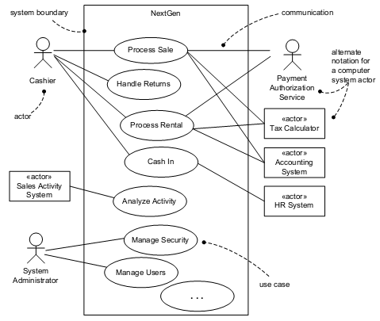
Notation of Use Case Diagrams

Slide 21
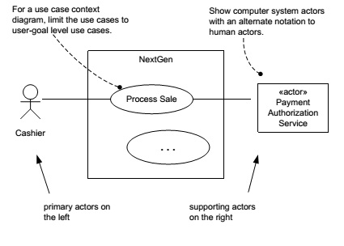
Notation of Use Case Diagrams
2 types of Actors:

Slide 22
Notation of Use Case Diagrams
2 types of Actors:
Primary actor has user goals fulfilled through using services of the System. One actor may represent several people
Supporting actor provides/ receives a service (information) to the system. Often a computer system, but could be an organization or person

Slide 23
Notation of Use Case Diagrams
Use cases
drawn as ellipses with a name in each ellipse
the name is usually an active verb & a noun phrase
describe a sequence of actions that the system performs to achieve an observable result of value to an actor
Use Case Name

Slide 24
Notation of Use Case Diagrams
Communication associations
line drawn between an actor and a use case
can have arrow heads to show where the communication is initiated (arrow points away from the initiator)
represent communication link between an instance of the use case and an instance of the actor

Slide 25
Notation of Use Case Diagrams
Dependencies
Extend and Include relationships between use cases
shown as stereotyped dependencies
stereotypes are written as text strings in guillemets: «extend» and «include»
Stereotypes are UML notation

Slide 26
Notation of Use Case Diagrams
Assign staff to work on a campaign
«include»
Find Campaign
«include»
Assign a new advert to a campaign
Campaign Manager
«include»
Check campaign budget
«extend»
Print Campaign Invoice
«extend»
Print Campaign Summary

Slide 27
Notation of Use Case Diagrams
Extend relationship
one use case provides additional functionality that may be required in another use case
there may be multiple ways of extending a use case, which represent variations in the way that actors interact with the use case
extension points show when the extension occurs
a condition can be placed next to the dependency arrow (Note that it is not put in square brackets).
Extending use case typically defines optional behaviour that is not necessarily meaningful by itself

Slide 28
Notation of Use Case Diagrams
Extend Relationship
Check campaign budget
Extension Points
Summary Print:
System displays balance
Campaign Manager
«extend»
User requires printout
Print Campaign Summary

Slide 29
Notation of Use Case Diagrams
Include relationship
one use case always includes the functionality of another use case
a use case may include more than one other
can be used to separate out a sequence of behaviour that is used in many use cases
should not be used to create a hierarchical functional decomposition of the system

Slide 30
Notation of Use Case Diagrams
Include relationship
Assign staff to work on a campaign
«include»
Find Campaign
Campaign Manager

Slide 31
Notation of Use Case Diagrams
Generalization
shows that 1 use case provides all the functionality of the more specific use case and some additional functionality
shows that 1 actor can participate in all the associations with use cases that the more specific actor can plus some additional use cases.
It similar to generalization between classes – child use case inherits properties and behaviour of the parent use case and may override the behaviour of the parent.

Slide 32
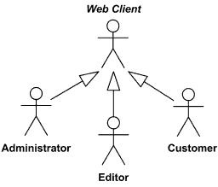
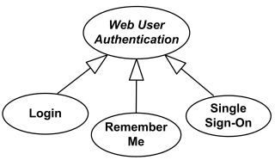
Notation of Use Case Diagrams
Generalization

Slide 33
Notation of Use Case Diagrams
Generalization
Record completion
of an advert
Staff Contact
Change a client
contact
Assign individual staff to work on a campaign
Assign staff to work on a campaign
Assign team of staff to work on a campaign
Campaign Manager

Slide 34
Use Case Description/Specification
Use Case Diagram will be supported by Use Case Description/Dpecification
Format:
name of use case
brief description
actors
preconditions (optional) – things that must be true before the use case can take place
main flow what does the actor do to create deliverables and how do the deliverables flow to other subsystems
Subflows (optional)
alternative flows (alternative courses)
postconditions (optional) - things that must be true after the use case has taken place

Slide 35
Use Case Diagram: Example
Soda Machine System
Purchase Drink
Customer
Restock Drink
Supplier
Collect Money
Collector

Slide 36
Use Case Diagram: Example
Use Case Specification
Use Case | Purchase Drink
Brief Description | This use case allows customer to buy a can of soda from Soda Machine
Actor | Customer
Preconditions(*) | A thirsty customer

Slide 37
Use Case Diagram: Example
Use Case Specification: Main Flow of Events
Actor Action | System Response
1. Insert coins into machine | 2. Verify the coins inserted
3. Enter the selection of drinks | 4. Match the inserted coins & price of drink selection 5. Deliver a can of drink.

Slide 38
Use Case Diagram: Example
Use Case Specification: Alternative flows (other scenarios)
A1. Step 4:
If the selected drink does not have enough stock
system presents a message ‘sold out ’,
the system prompts a message & ask the customer for another selection.

Slide 39
Use Case Diagram: Example
Use Case Specification: Alternative flows (other scenarios)
A2. Step 4:
If amount of payment given are less than price of drink
System presents a message ‘balance not enough’.

Slide 40
Use Case Diagram: Example
Use Case Specification: Alternative flows (other scenarios)
A3. Step 5:
If amount of payment given is more than price of drink
System delivers the selected drink & refund the extra change.
Postconditions(*): The customer received a can of soda or the returned money

Slide 41
Conceptual Modeling
i) Context Models
ii) Interaction Models
iii) Structural Models
iv) Behavioral Models

Slide 42
Conceptual Modeling
iii) Structural Models
Display the organization of a system in terms of the components that make up that system and their relationships
Eg: Class Diagram in UML {discuss in this chapter)
Display the organization of data or entities
Eg: Entity Relationship Diagram (ERD)
{Refer to Database & SAD course}

Slide 43
Conceptual Modeling
Generally,
Class diagram in the UML, is the main building block of object-oriented modelling. It is commonly used for general conceptual modeling of system’s structure
Object diagram in the UML shows a complete or partial view of the structure of a system at a specific time
ER model is commonly formed to represent things that a business needs to remember in order to perform business processes.

Slide 44
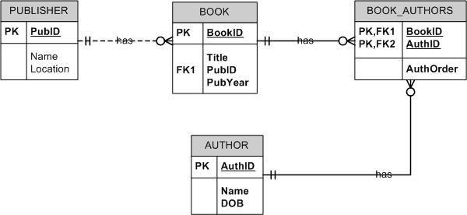
Example : Entity Relationship Diagram (ERD)

Slide 45
Object – UML Notation
Two compartments:
Object name
Object attribute
Does not provide compartment for operation
objectName:className
attributeName=value
OOAD:Subject
courseID=“BACS2053” courseName=“Object Oriented Analysis and Design”

Slide 46
Class – UML Notation
A class is a description of a group of objects with common properties (attributes), behavior (operations) & relationships.
An object is an instance of a class.
A set of objects that share the same attribute and operation.

Slide 47
Class – UML Notation
A class is represented using a rectangle with 3 compartments:
The class name
The structure (attributes)
The behaviour (operations)
Professor
Class Name
Attributes:Type
Operations()
- name
- employeeID : UniqueId
- hireDate
- status
- discipline
- maxLoad
+ submitFinalGrade()
+ acceptCourseOffering()
+ setMaxLoad()
+ takeSabbatical()
+ teachClass()

Slide 48

Class - Example
Class
Course
Properties
Name
Location
Days offered
Credit hours
Start time
End time
Behavior
Add a student
Delete a student
Get course roster
Determine if it is full

Slide 49
Class Diagram: Generalization
Generalization: a taxonomic relationship between a more general element and a more specific element.
More general bits of description are abstracted out from specialized classes
Every subclass contains at least one characteristic that is unique.
For example, a person may be an employee, a customer, a supplier of a service
An employee may be paid monthly, weekly or hourly
An hourly paid employee may be a driver, a cleaner, a sales assistant

Slide 50
Generalization – UML Notation
Person
More General
(Superclasses)
Employee
Customer
Supplier
Monthly Paid
Weekly Paid
Hourly Paid
Driver
Cleaner
Sales Assistant
More Specialize
(Subclasses)

Slide 51
Generalization – UML Notation
A relationship among classes where one class shares the structure and/or behavior of one or more classes
Defines a hierarchy of abstractions in which a subclass inherits from 1 or more superclasses
Single inheritance
Multiple inheritance
Generalization is an “is-a-kind of” relationship
Notes:
Generalization relationships are also permitted between packages. However, since packages do not themselves have any semantics, generalization between packages is not very common (generalization amongst subsystems, however, is practical).
According to Grady Booch: “The terms “inheritance” and “generalization” are, practically speaking, interchangeable. The UML standardized on calling the relationship “generalization” so as not to confuse people with language-specific meanings of inheritance. To confuse matters further, some call this an “is-a” or a “kind of” relationship (especially those into conceptual modeling in the cognitive sciences). So, for most users, it’s fair to use either term. For power users - people who care about things like the UML metamodel and specifying formal semantics of the same, the relationship is called “generalization” and applying such a relationship between, for example, two classes, results in the subclass inheriting the structure and operations of the superclass (i.e. inheritance is the mechanism).

Slide 52
Inheritance – UML Notation
In OOAD, inheritance is defined as a mechanism by which more specific classes (called subclasses/derived classes) incorporate structure and behavior of more general classes (called superclasses /base classes).
Inheritance supplements generalization relationship.
The whole description of a superclass applies to all its subclasses, including: Information structure and behaviour. It allows code for reuse (classes) from previous project.

Slide 53
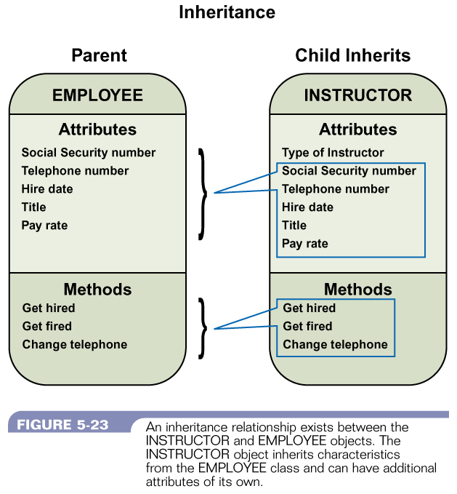
Generalization & Inheritance

Slide 54
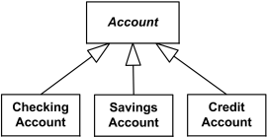
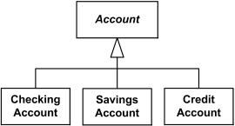
Class Diagram: Inheritance
Single inheritance: one class inherits from another

Slide 55
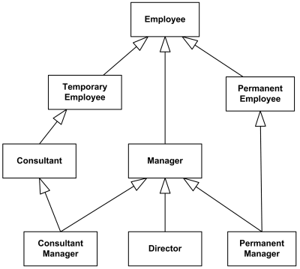
Inheritance – UML Notation
Multiple inheritance: A class can inherit from several other classes
Use multiple inheritance only when needed, and
always with caution !

Slide 56
Class Diagram: Inheritance
Inheritance leverages the similarities among classes
What get inherited?
A subclass inherits its parent’s attributes, operations, and relationships.
A subclass may:
Add additional attributes, operations, relationships
Redefine inherited operations (use caution!)
Common attributes, operations, and/or relationships are shown at the highest applicable level in the hierarchy

Slide 57
Class Diagram: Associations
Associations represent:
The possibility of a logical relationship or connection between objects of one class and objects of another
If two objects can be linked, their classes have an association (as illustrated in next 2 slides)

Slide 58
Class Diagram: Associations
Association
Association role
Client
Staff
companyAddress
companyEmail
companyFax
companyName
companyTelephone
staffName
staffNo
staffStartDate
staffContact
liases with
Association name
Direction in which name should be read

Slide 59
Object Diagram: Links
Connection between two object instances
Yellow Partridge:Client
A link is a logical connection between two objects
FoodCo:Client
Grace Chia:StaffMember
Soong Motor Co:Client
Carlos Moncada:StaffMember

Slide 60
Class Diagram: Multiplicity
Associations have multiplicity
Multiplicity is the range of permitted cardinalities of an association
Definite value
Indefinite value
Range of value
Set of value
Most frequent multiplicity
0..1 0..* 1 1.. * *
2
*
5..15
2, 4, 6

Slide 61
Class Diagram: Multiplicity
Represent enterprise (or business) rules
E.g.:
Any bank customer may have one or more accounts
Every account is for ONE, and ONLY ONE, customer
has
Customer
Account
1
1..*

Slide 62
Class Diagram: Multiplicity
Client
StaffMember
companyAddress
companyEmail
companyFax
companyName
companyTelephone
staffName
staffNo
staffStartDate
1
0..*
liases with
Exactly one staff member liaises with each client
A staff member may liaise with zero, one or more clients

Slide 63
Class Diagram: Association Degree
Degree of an association denotes the number of classes involved in a connection
Unary
Binary
Ternary

Slide 64
Class Diagram: Association Degree
Unary
+can_be_manager_of
0..*
Employee
0..1
+can_be_managed_by
Notes:
An employee (manager) can be manager of ZERO to MANY employees
An employee (staff) can be managed by ZERO (you are your own boss) to ONE employee (Manager)

Slide 65
Class Diagram: Association Degree
Binary
Teacher
taught_by
1..*
1
is_managed_by
0..*
teaches
CourseOffering
0..*
is_in_charge_of

Slide 66
Class Diagram: Association Degree
Ternary
Part
Vendor
Shipment
Warehouse

Slide 67
Class Diagram: Complex Association
Any number multiplicity marked at both ends of the association (*..*)
borrow
Person
Book
*
*
Can be solved by:
Association class
Qualified Association

Slide 68
Class Diagram: Complex Association
Association Class
Used in analysis phase to solve many-to-many relationships
Association get coded as a class
The name of an association class must be the same as the name of the original association itself

Slide 69
Class Diagram: Complex Association
Association Class
borrow
Person
Book
*
*

Slide 70
Class Diagram: Complex Association
Association Class
Person
Book
*
*
borrow
Borrow
fromDate
toDate
Association Class

Slide 71
Class Diagram: Complex Association
Association Class
Person
Borrow
Book
1
0..*
PersonID
BookID
fromDate
toDate
0..*
1
The association class is drawn as an individual class with a separate association to each of the other classes

Slide 72
Class Diagram: Complex Association
Qualified Association
Assign a unique attribute value/qualifier
E.g. a bank has many customers, but each customer can have accounts at many banks
Banks with
Bank
Customer
*
*

Slide 73
Class Diagram: Complex Association
Qualified Association
From the bank’s perspective , the situation is resolved each time because each customer is given a Unique Customer Number.
At any time, the bank needs to refer to a customer, the custRef attribute on the class acts as an index directly to the customer concerned

Slide 74
Class Diagram: Complex Association
Qualified Association
Banks with
Bank
Customer
*
*
custRef

Slide 75
Class Diagram: Complex Association
Qualified Association
The customer can have many accounts with different banks. But customer know that they can always refer to the exact bank they want by using the Bank’s Unique Code
Banks with
Bank
Customer
*
*
bankCode

Slide 76
Conceptual Modeling (2)
i) Context Models
ii) Interaction Models
iii) Structural Models
iv) Behavioral Models

Slide 77
Conceptual Modeling (2)
iv) Behavioral Models
model of the dynamic behavior of a system as it is executing
Show what happens or what is supposed to happen when a system responds to a stimulus (data or events) from its environment
Eg: i) State diagram in UML {discuss in this chapter}
ii) Sequence diagram in UML {discuss in Chp 5}

Slide 78
State Diagram – Object Behavior
Used to model the dynamic behavior of classes
Defines object responses to messages – object behavior
When statechart is used:
Object’s life change from state to state
How to identify states:
status conditions that may need to report to the management or customers
Draw 1 statechart for 1 entity class – not all entities classes ( only complex life cycles)

Slide 79
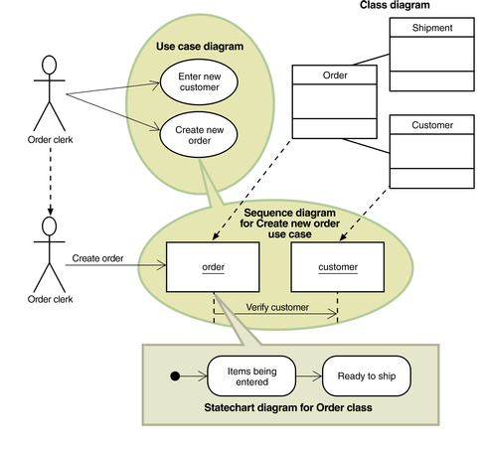
Relationships Between OO Models

Slide 80
State Diagram – Object States
Condition during an object’s life
Satisfies a criteria
Performs an action
Waits for an event
Semi-permanent conditions
External events cause object to move to a new condition

Slide 81
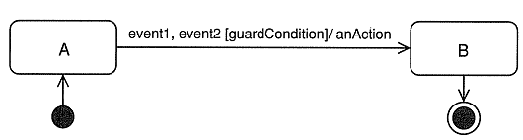
State Diagram – Object State Naming Conventions
May be a simple condition such as ‘on’ or ‘off’
May be active names consisting of gerunds or verb phrases

Slide 82
State Diagram – Object State Naming Conventions
Statechart Symbols
Statename
start
end
Transition

Slide 83
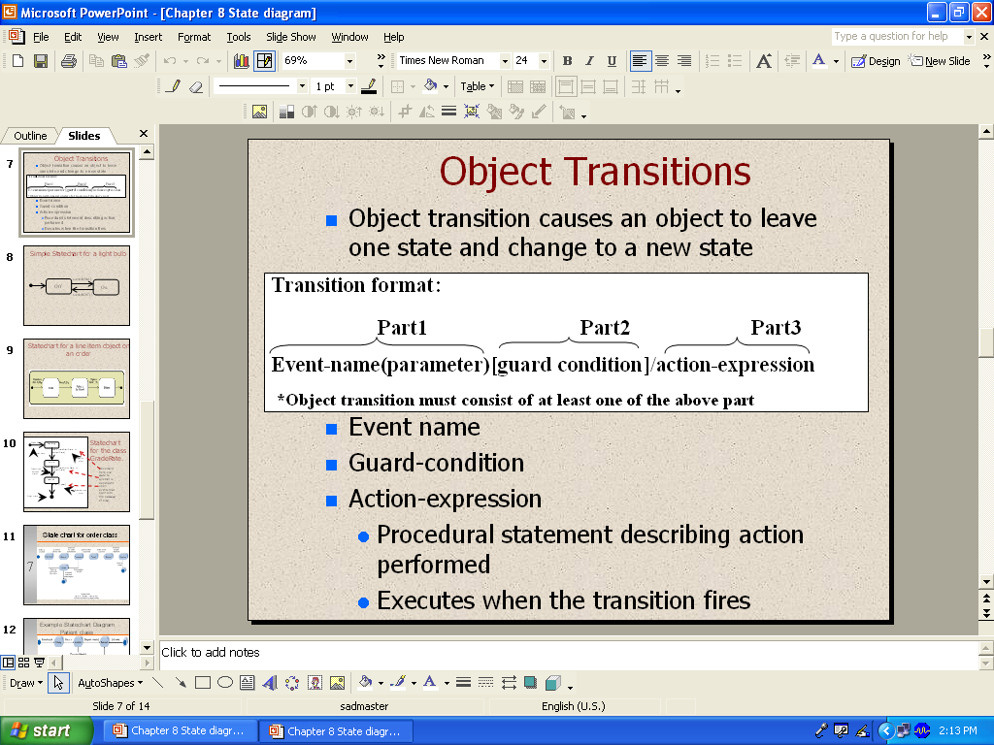
State Diagram – Object Transitions
Object transition causes an object to leave one state and change to a new state

Slide 84
State Diagram – Object Transitions
Event name
Guard-condition
Action-expression
Procedural statement describing action performed
Executes when the transition fires

Slide 85
State Diagram – Payment Class with Events
checkAmount()
Unpaid
partialPay()
Partly Paid
fullPay()
fullPay()
Fully Paid

Slide 86
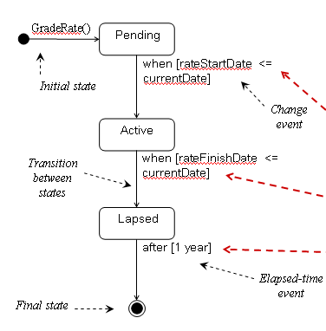
State Diagram – GradeRate Class
Movement from one state to another is dependent upon events that occur with the passage of time.

Slide 87
State Diagram Life of A Class - Order
The customer creates an order on the web.
The customer submits the order once he/she is finished.
The credit authorization needs to be approved for the order to be accepted.
If denied, the order is returned to the customer for changes or deletion.
If accepted, the ordered is placed.
The order is shipped to the customer.
The customer receives the order
The order is closed.

Slide 88
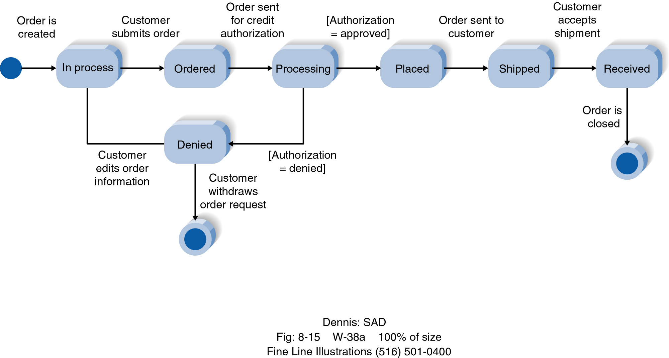
State Diagram : Order Class

Slide 89
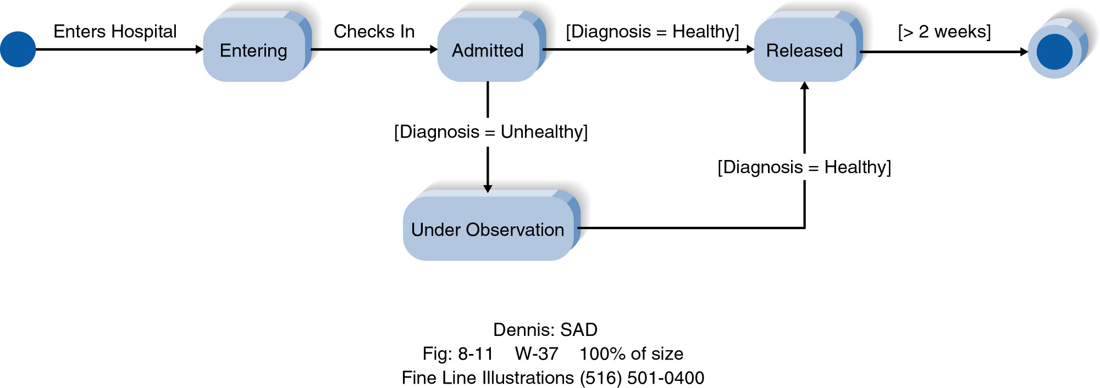
State Diagram : Patient Class

Slide 90
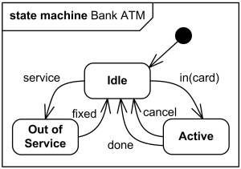
State Diagram : ATM Machine

Slide 91
Statechart Development – Guidelines
Review class diagram and select classes needing statecharts
Identify input messages across all sequence diagrams for selected class
For each selected class in group, make a list of all states
Build statechart fragments and sequence fragments in correct order
Review paths and look for independent concurrent paths
Expand each transition with the appropriate message event, guard condition, and action expression
Review and test each state chart

Slide 92
Requirements Analysis: outline
Requirements Classification
Conceptual Modelling
Context Models
Interaction Models
Structural Models
Behavioral Models
Architectural Design and Requirements Allocation
Requirements Negotiation
Requirements Analysis Approaches

Slide 93

Architectural Design and Requirements Allocation (1)
In many cases, requirements engineer acts as a software architect
The process of analysing and elaborating the requirements demands the architecture/design of components that will be responsible for satisfying the requirements be identified
Requirements Allocation – the assignment to architecture components responsible for satisfying the requirements.

Slide 94

Architectural Design and Requirements Allocation (2)
Why Requirements Allocation?
It is important to permit detailed analysis of requirements. Once a set of requirements has been allocated to a component, the individual requirements can be furthered analyse and to discover further
For large project, allocation stimulates a new round of analysis for each subsystem.

Slide 95
Architectural Design and Requirements Allocation (3)
However the requirements engineer should keep the following points in mind
Do not allow assumptions about the design to influence the requirements analysis.
Do not allow the requirements analysis to prejudge the system design.

Slide 96
Requirements Analysis: outline
Requirements Classification
Conceptual Modelling
Context Models
Interaction Models
Structural Models
Behavioral Models
Architectural Design and Requirements Allocation
Requirements Negotiation
Requirements Analysis Approaches

Slide 97
Requirements Negotiation
Concern resolving problems with requirements where conflicts occur between two stakeholders
For eg: mutually incompatible features, requirements (functional or non-functional), resources & etc
Consult with stakeholder(s) to reach a consensus on a appropriate tradeoff
However, strong case will be made in Requirements Evaluation stage (next chapter)

Slide 98
Requirements Analysis: outline
Requirements Classification
Conceptual Modelling
Context Models
Interaction Models
Structural Models
Behavioral Models
Architectural Design and Requirements Allocation
Requirements Negotiation
Requirements Analysis Approaches

Slide 99
Requirements Analysis Approaches
Requirement gathering and requirements analysis - The main difference is that:
The requirements gathering phase tries to understand what the user needs and their usage of the system
The analysis phase will be used to understand the system itself in addition to the user usage
There are various approaches for requirements analysis. Among others, the commonly used approaches are:
Viewpoint-oriented analysis
Method-based analysis:
Structured/ Data Flow Based Analysis
Object-Oriented Analysis

Slide 100

Viewpoint–oriented analysis (Recall – Covered in SE course)
For any medium-sized or large system, there are usually different types of end-users
A viewpoint may be considered as :
A data source or sink
A representation framework
A receiver of services

Slide 101
Requirements Discovery : Viewpoint-oriented analysis (Recall – Covered in SE course )
Viewpoint-oriented analysis is an approach that helps to ensure get broad stakeholder coverage when discovering requirements.
Viewpoints can be used to classifying stakeholders and other sources of requirements.
Problem
to be
analysed

Slide 102
Requirements Discovery : Viewpoint-oriented analysis (Recall – Covered in SE course )
Three generic types of viewpoints:
Interactor viewpoints – people or other systems that interact directly with the system
Indirect viewpoints – stakeholders who do not use the system themselves but who influence the requirements in some way
Domain viewpoints – domain characteristics and constraints that influence the system requirements

Slide 103
The Advantages of viewpoint-oriented analysis
In the majority of interactive systems, it in natural to think of end-users as receivers of system services.
Because they are external to the system, viewpoints are a natural way to structure the requirements elicitation process.
It is relatively easy to decide if some agent is or is not a valid viewpoint.
How about other advantages?
Discuss during lecture...

Slide 104
The Disadvantages of viewpoint-oriented analysis
Tedious task and need time/efforts to prepare the VP hierarchy
Hard to identify VPs and classify them

Slide 105
Method-based analysis
Structured methods usually include some or all of the following :
A process model
System modelling notations
Rules applied to the system model
Design guidelines
Object-oriented (OO) analysis and Structured/Data-flow based methods are fairly widely used.

Slide 106
OO Analysis
OOA is “ a method of analysis that examines requirements from the perspectives of the classes and object.” (Booch 1995)
Emphasis is on finding and describing conceptual objects which are relevant to the problem

Slide 107
OO Analysis
Analyze objects and data - Together
Objects identification → Object Diagram
Identify the properties (Attributes) & behaviour (methods/operations) of objects → Initial Class Diagram
Analyse the relationship between objects → Object Diagram & Initial Class Diagram
Analyse the Interaction between objects → Analysis Sequence Diagram (Focuses on Entity objects ie without UI & Control objects)
understand the message(s) between objects
sequence of interactions ie sequence of message passing
Identify possible states of an object → State Diagram

Slide 108
OO Analysis
Common approaches to identify objects & classify of Objects
Grammatical analysis of a natural description of a system -> Objects & attributes are nouns
Tangible entities (things)
Behavioural-approaches – understand overall behaviour of a system -> identify objects
Scenario-based analysis – scenarios of system use are identified and analysed -> identify the required objects, attributes & operations

Slide 109
Structured/ Data-flow based method {Refer to SAD course for details}
Analyse Processes and Data – Separately
Identify external entities and the boundary
Identify processes/ sub processes
Identify input and output data flows
Identify data stores and analyse the data within the data stores

Slide 110
ANY QUESTION…

